Slide 1
Basic Configuration Management Tool
(Project Code:194)
Using CRUD Operations
C – Create
R – Read
U – Update
D – Delete
Presented by:
A Rohan Sudhan
M Mahenoor
Priyanka V
K Pranav
Rida Arshad

Slide 2
Problem Statement:
Basic configuration management tool
POC CRUD configuration files, deploy_configuration_files(config id): Deploy configuration to the servers.
Track_changes_history(history_details): keep a log of all configuration changes.
Code for the problem statement outlined, we will develop a simple configuration management tool using OOP principle in python.
We will define classes for handling configuration files and for maintaining logs of configuration changes.
Since interaction with actual servers or database is not the part o requirement. operations on data and logs will be simulated using in memory dictionary and tests.

Slide 3
INTRODUCTION:
Configuration management is a systems engineering process for establishing consistency of a product’s attributes throughout its life.
In the technology world, configuration management is an IT management process that tracks individual configuration items of an IT system.
Specifications of computational hardware resource allocations for CPU, RAM, etc.
Endpoints that specify external connections to other services, databases, or domains
Secrets like passwords and encryption keys

Slide 4
Benefits of Configuration Management:
Configuration management helps engineering teams build robust and stable systems through the use of tools that automatically manage and monitor updates to configuration data.
Complex software systems are composed of components that differ in granularity of size and complexity.
Configuration management tools:
Ansible
Chef
Puppet

Slide 5
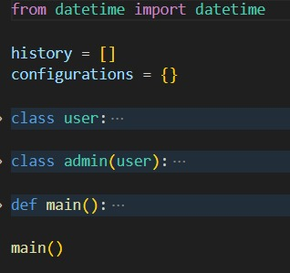
Skeleton :

Slide 6
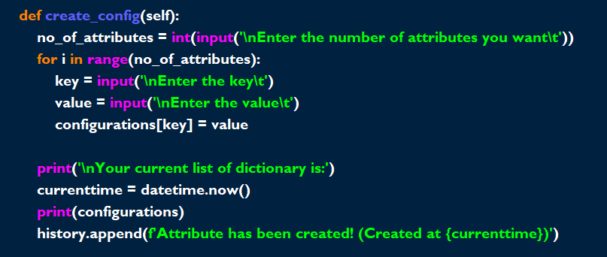
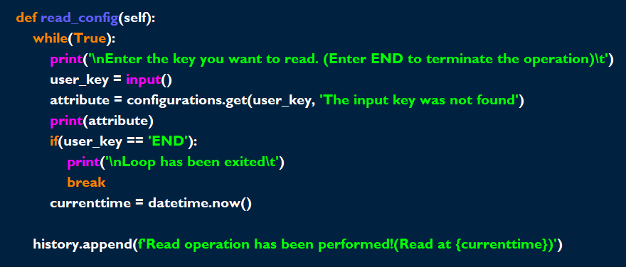
Inside class(user):

Slide 7
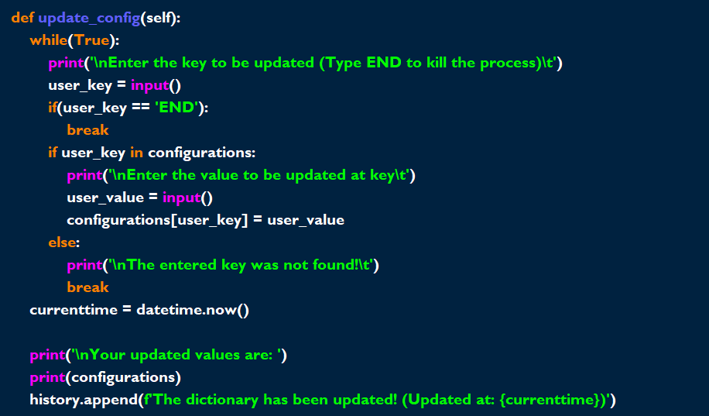
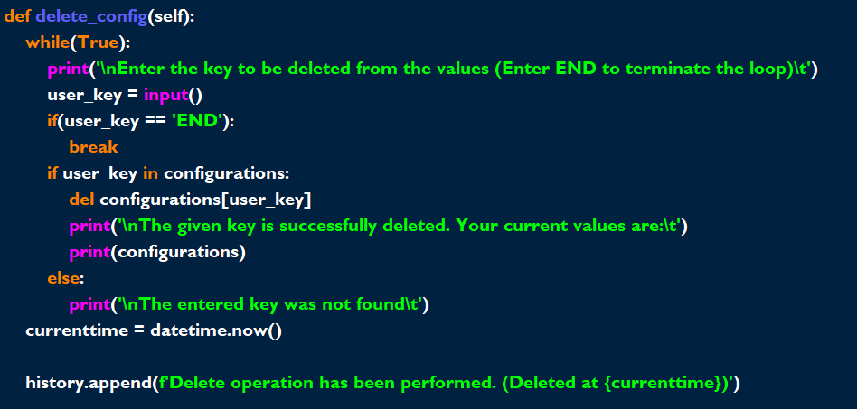
Inside class admin(user)

Slide 8
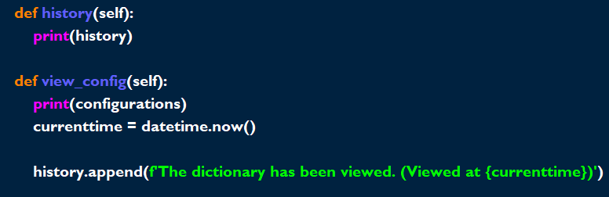

Slide 9
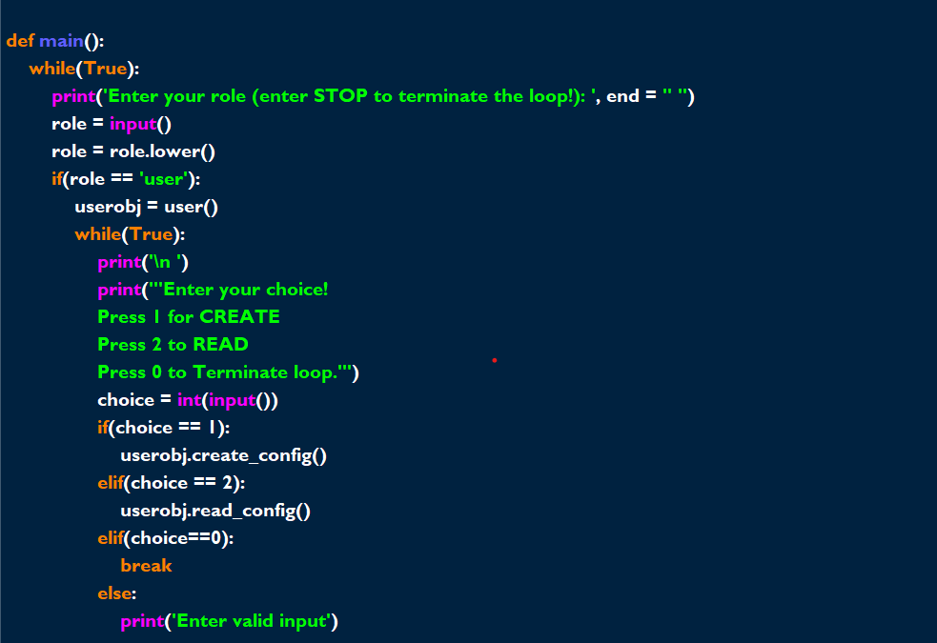
Inside main()

Slide 10
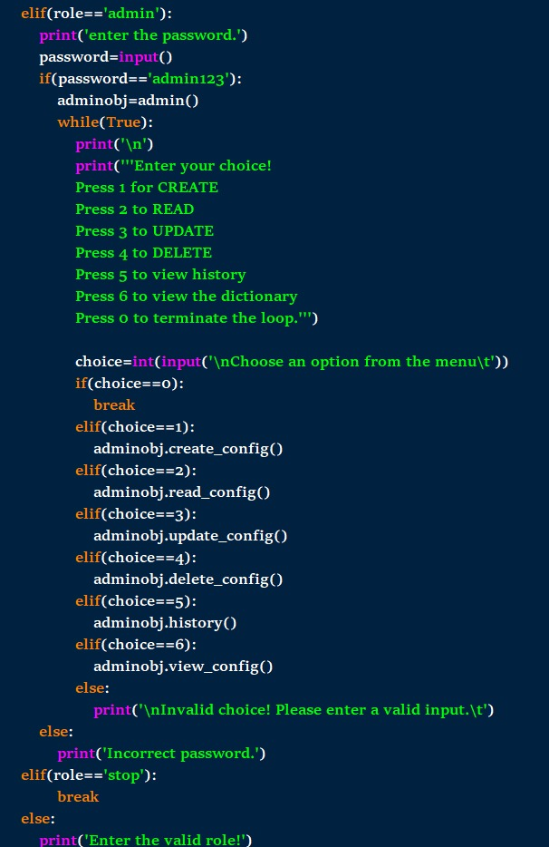
Role selection
Admin
Or
User
Choices and permssions
Object creation and Function calling
Loop breaks

Slide 11
Real Life Scenario:
Dictionary Structure:
Configurations Dictionary:
Key: Client ID (or Client Name)
Value: A dictionary containing configuration details like IP addresses, security settings, and database configurations.
Change Log Dictionary:
Key: Client ID (or Client Name)
Value: A list of strings, each string representing a change made to that client's configuration.
Example Dictionary Representation:
Configurations{
“firewall_config” : “Allow port 20, Deny port 22” ,
“ Server_IP” : “1.0.11.254.123” ,
“firewall_status” : “Active” ,
}

Slide 12
Conclusion:
Configuration management is a necessary tool for managing complex software systems. Lack of configuration management can cause serious problems with reliability, uptime, and the ability to scale a system.
Many current software development tools have configuration management features built in.
Bitbucket offers a powerful system for configuration management that is built around Git pull request workflows and CI/CD pipelines.

Slide 13
References:
https://realpython.com/python-gui-tkinter/
https://youtu.be/VMP1oQOxfM0?si=pa26e_VikeImr2bo
https://www.coursera.org/learn/python-for-applied-data-science-ai/home/module/3 {coursera coach}

